Slide 1
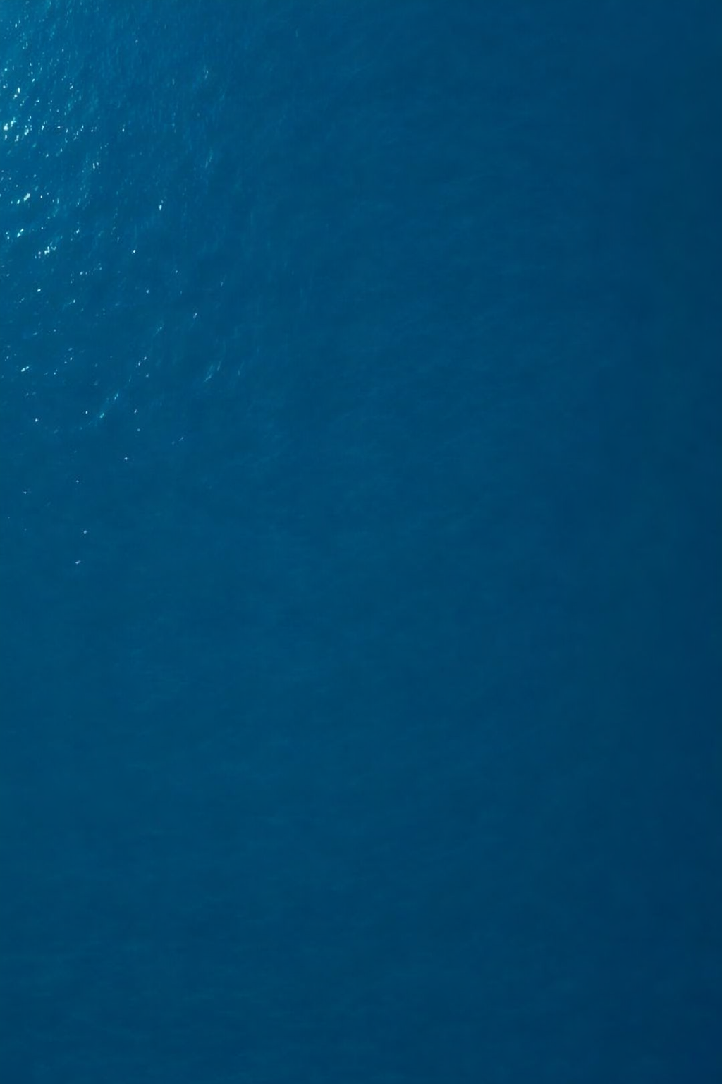
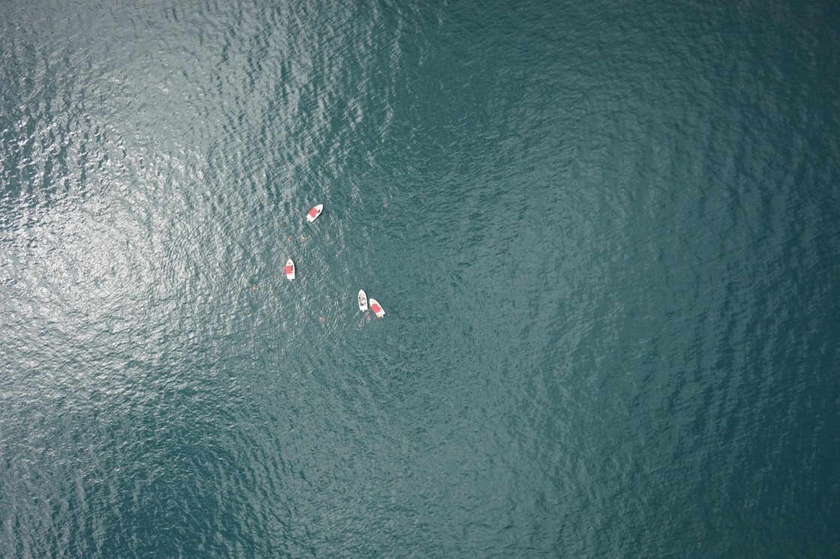
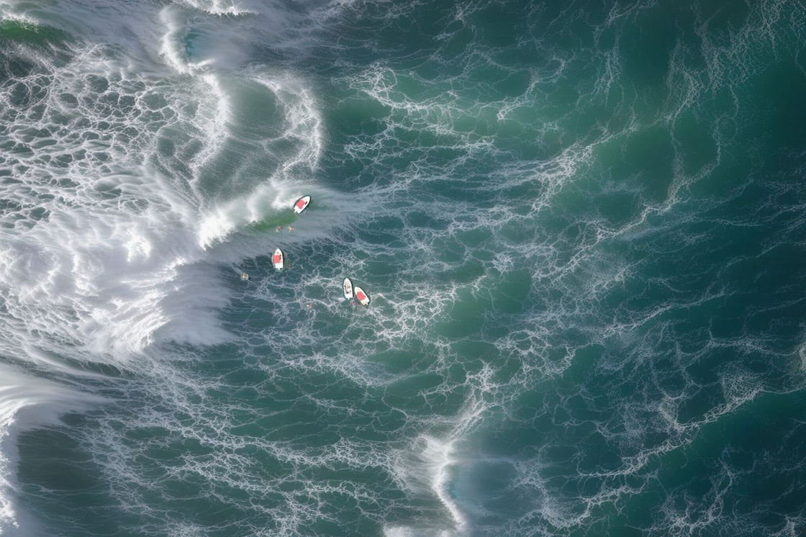
STORMVISION
Presenter: Tomer Atia, shalev cohen, Noam hadad
Maritime Object Detection from Aerial Drone Imagery in Stormy Conditions using Synthetic Data Augmentation
ORIGINAL IMAGE
SYNTHETIC IMAGE

Slide 2
Review & Refined Project Definition
Maritime search-and-rescue operations rely heavily on drone-based detection of swimmers, boats, and other small objects.
The Data Gap:
There is currently NO publicly available labeled dataset of aerial drone footage capturing maritime objects in stormy sea conditions.
INPUT
OUTPUT
Calm-sea drone images with COCO annotations
SeaDronesSee Dataset:
Detection: Bounding boxes for 5 object classes
swimmer | boat | jetski | life_saving_appliances | buo
Trained Model: YOLOv8s robust to stormy conditions
8,262 train | 1,547 test

Slide 3


Project Achievements and Novelty
PROJECT ACHIEVEMENTS
End-to-end pipeline for maritime object detection under adverse weather conditions
Synthetic stormy background generation pipeline:
Image → masks+depth map → SDXL Inpaint+ControlNet → Composite
Controlled comparison: COCO Pretrained vs Real-Only vs Real+Synthetic (Mixed)
DELIVERABLES
Robust YOLOv8 detector for stormy maritime conditions
5,678 synthetic images of stormy seas
Comprehensive evaluation on 3 test sets (Real, Synthetic, Mixed)
The project's novelty lies in generating synthetic stormy sea backgrounds while perfectly preserving original objects, addressing the critical data gap in maritime SAR.

Slide 4
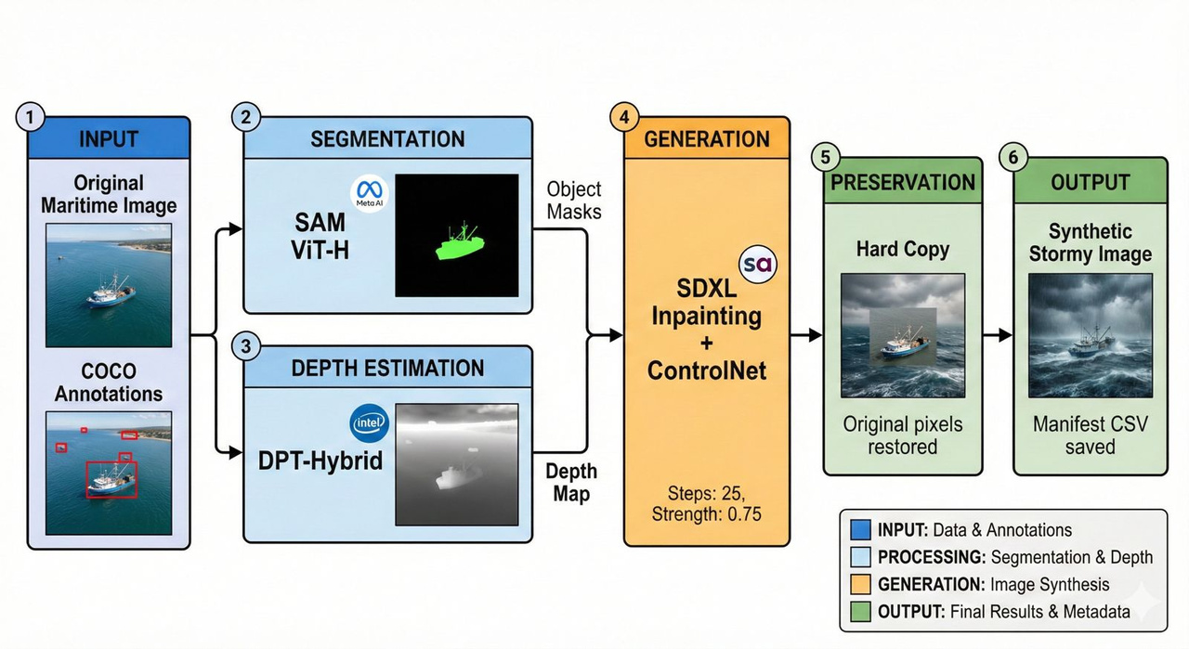
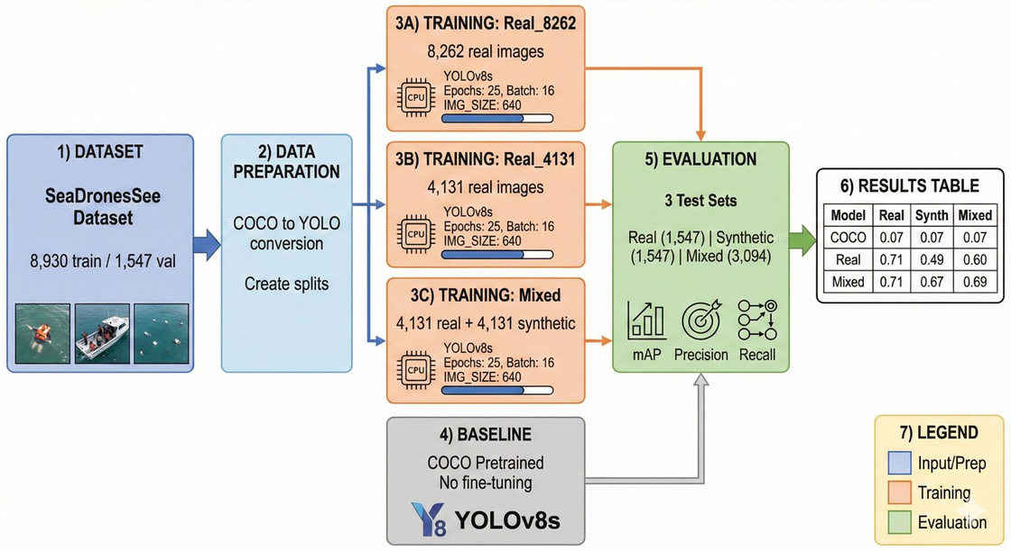
Review Methodology
input (Real + Labels)
Masks (SAM)
Depth
SDXL Inpaint+ControlNet
composite (Preserve Objects)
Paired Dataset
YOLO Train
Metrics + Qualitative Results
Synthetic stormy background generation (SAM + SDXL + ControlNet)
Object preservation via hard copy compositing
Model training & evaluation (4 models)
Robustness testing across 3 test sets

Slide 5
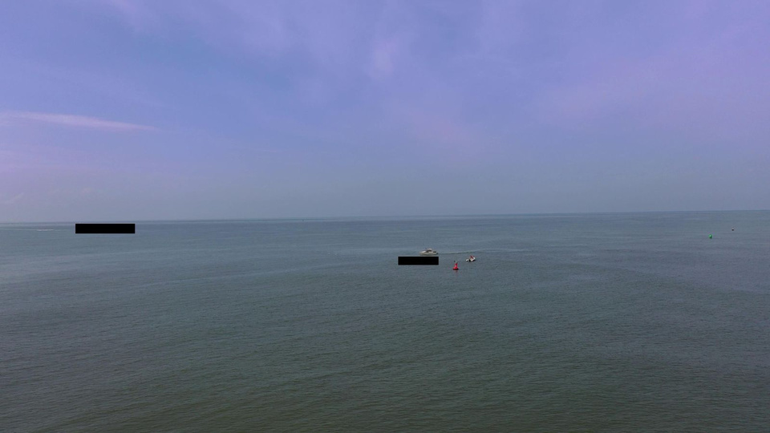
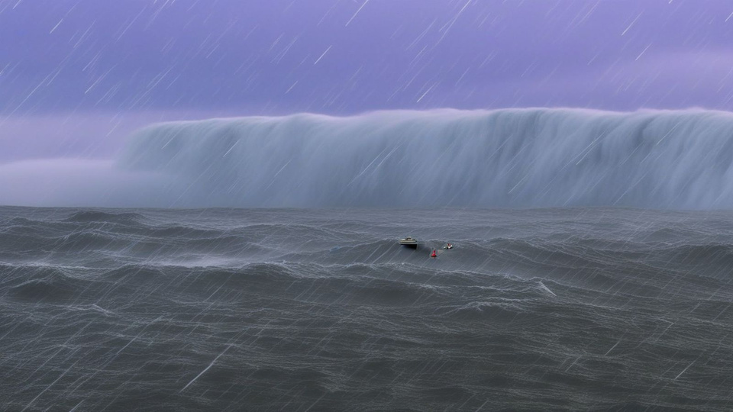
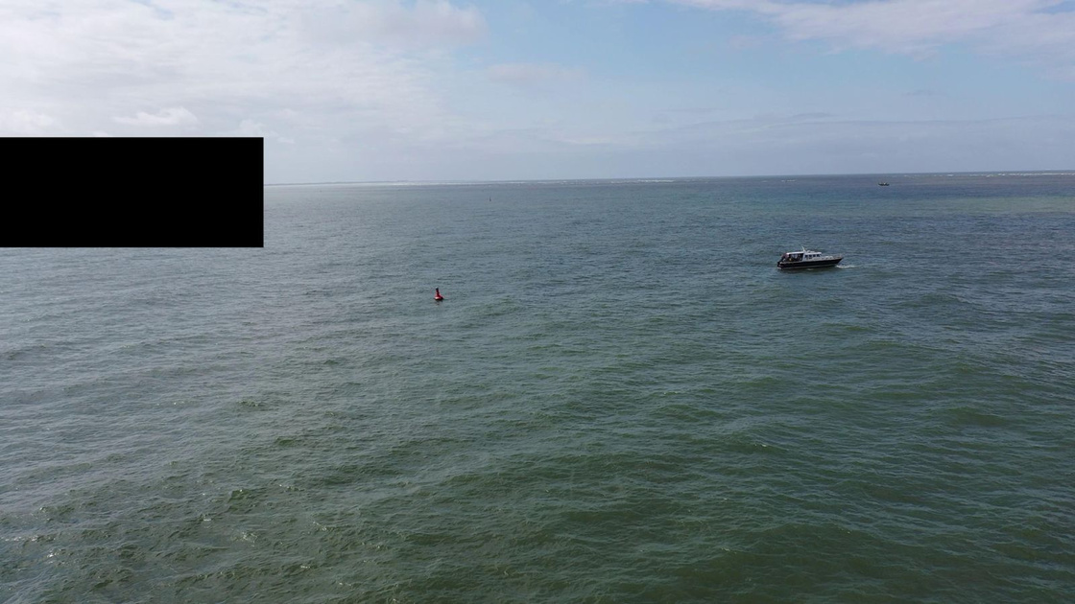
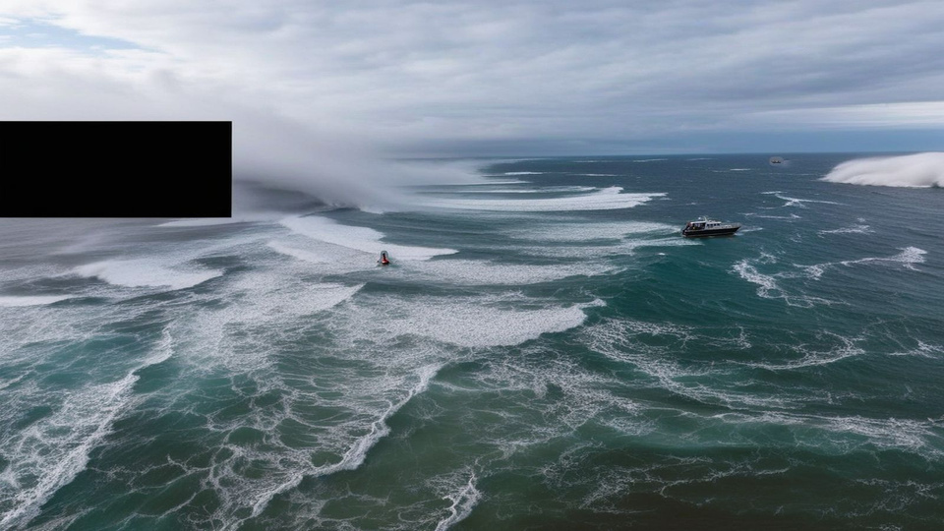
Examples
ORIGINAL IMAGE
SYNTHETIC IMAGE

Slide 6
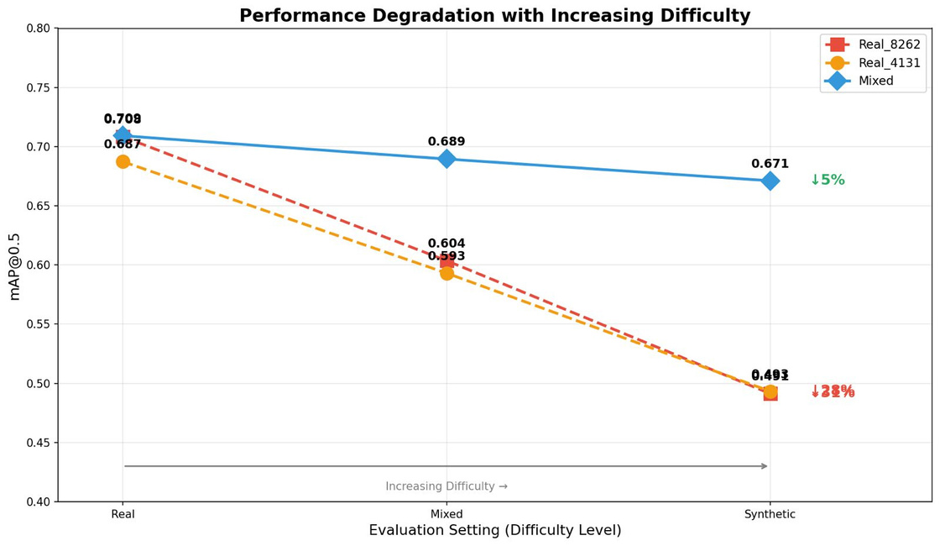
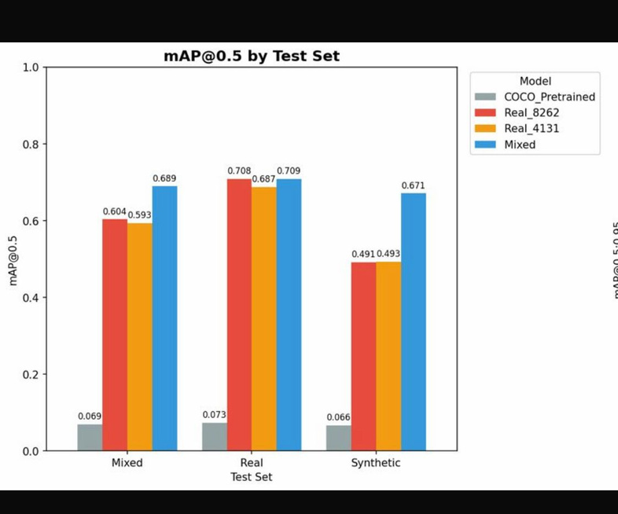
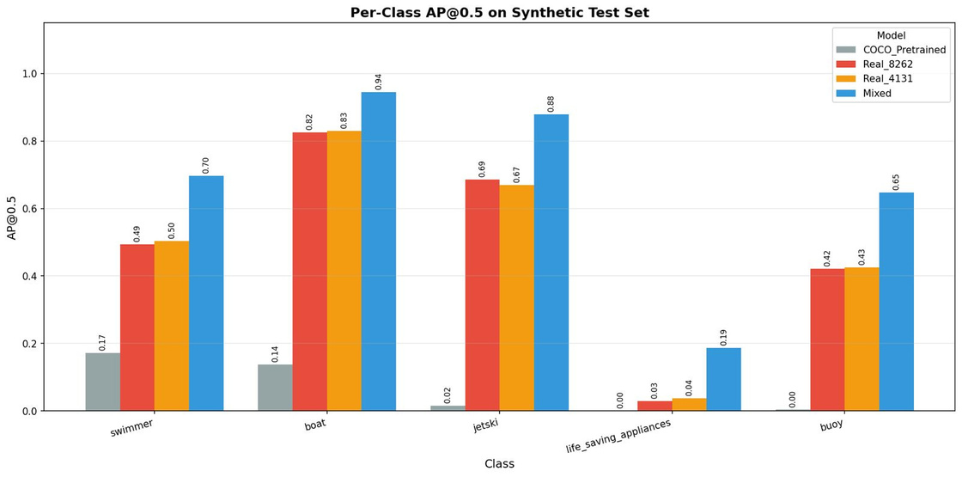
Results
Model Selection:
Mixed (Real+Synthetic) achieves best robustness
Mixed Model Final Performance:
mAP@0.5 = 0.709 (real)
mAP@0.5 = 0.671 (stormy)
Synthetic augmentation dramatically improves storm detection

Slide 7


Conclusion & Future Work
The pipeline successfully implements an end-to-end system for synthetic stormy sea data generation, enabling robust maritime object detection under adverse conditions.
REMAINING CHALLENGES:
Generated storms may lack extreme wave physics accuracy
Improved detection robustness: Mixed model shows only 5% performance drop on stormy images vs 28% for Real-only models (6x improvement).
Very small objects (<20px) may have minor artifacts after compositing
Demonstrated effectiveness: Synthetic data augmentation achieves x10 improvement over COCO baseline and +18% on synthetic test vs fair comparison.
IMPROVEMENT ACTIONS
ADDITIONAL EXPERIMENTS
Improve wave realism with physics-based simulation
Add more atmospheric effects (rain, fog, mist)
Fine-tune SAM for maritime-specific segmentation
Expand to night-time and low-visibility conditions
Test on real stormy footage when available
Try larger YOLO models (YOLOv8m, YOLOv8l)
Experiment with different synthetic-to-real ratios
Add temporal consistency for video processing
Cross-dataset validation with other maritime datasets

